Slide 1
Assignment 8 supervised Learning Part 1
5420 Anomaly Detection, Fall 2020
- Harsh Dhanuka, hd2457

Slide 2

5420 Anomaly Detection, Fall 2020
- Harsh Dhanuka, hd2457
Agenda
LOAN DEFAULT
Loan default occurs when a borrower fails to pay back a debt according to the initial arrangement.
Predict which loan holders will likely default
0 = No Default 1 = Default
Which techniques to use? Which Random Forest package to use? How to convey the results?
Around $20 billion defaults only in student loans in US

Slide 3
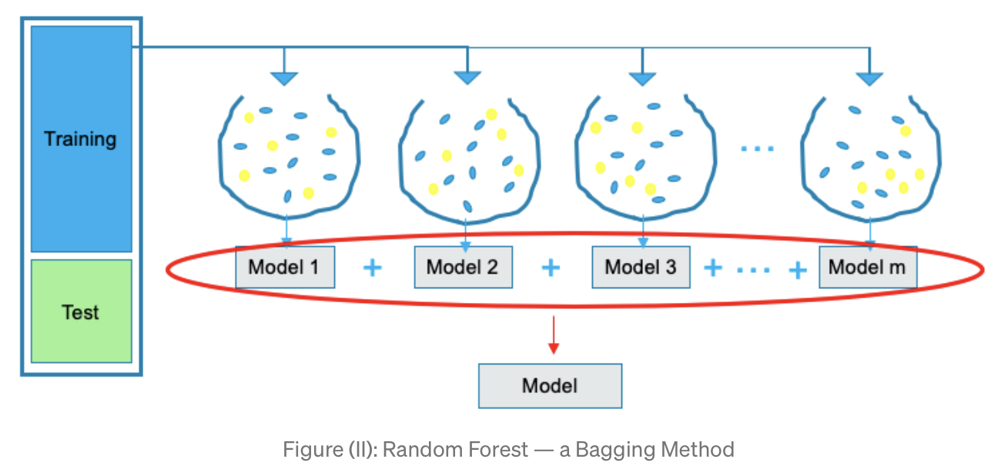
Random Forest
Random Forest is a type of Bagging Model. The random forest method builds many decision trees, and then takes the average for the outcomes of all the decision trees. Further, the random forest technique draws some samples to build a model, then draws some samples again to build another model, and so on.
H2O
H2O is a fully open source, distributed in-memory machine learning platform with linear scalability. H2O supports the most widely used statistical & machine learning algorithms including gradient boosted machines, generalized linear models, deep learning and more. H2O also has an industry leading AutoML functionality that automatically runs through all the algorithms and their hyperparameters to produce a leaderboard of the best models.

Slide 4
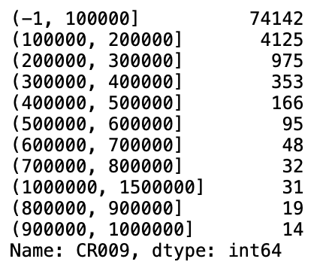
5420 Anomaly Detection, Fall 2020
- Harsh Dhanuka, hd2457
Considerations
1. Feature Engineering
Convert Date/Time columns
Education Code, Gender, City converted to categorical type
Drop empty value variables and constants
Bin the Loan Amount column
2. Missing values
Convert mis-represented NA’s such as -99, to np.nan
Use Iterative Imputer to fill with median
3. Dummy coding of Categorical variables not needed
4. Split to train_test
- I used 75% data in train set. Convert all dataframes to H2O hex format.
Loan Amount Bin ($) Count

Slide 5
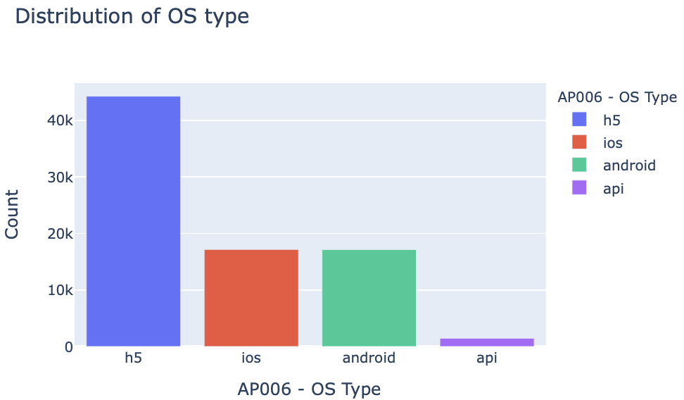
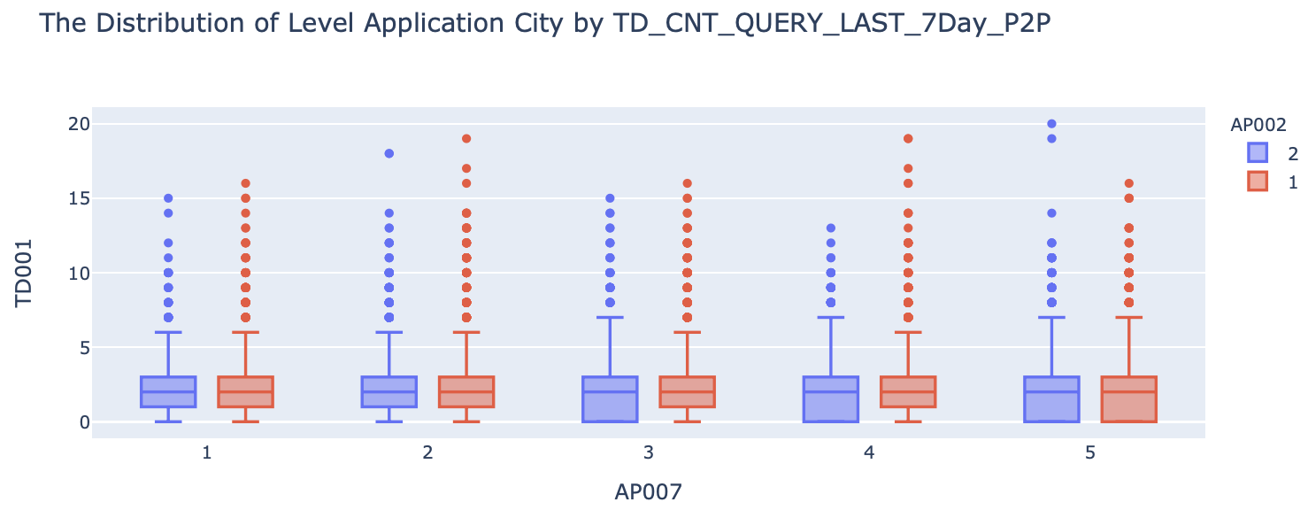
5420 Anomaly Detection, Fall 2020
- Harsh Dhanuka, hd2457
Exploratory Data Analysis
1
Distribution of AP006 – OS Type
2
Distribution of Application City (AP007) by the Count of Query in 7 days
Colored by Gender (AP002)

Slide 6
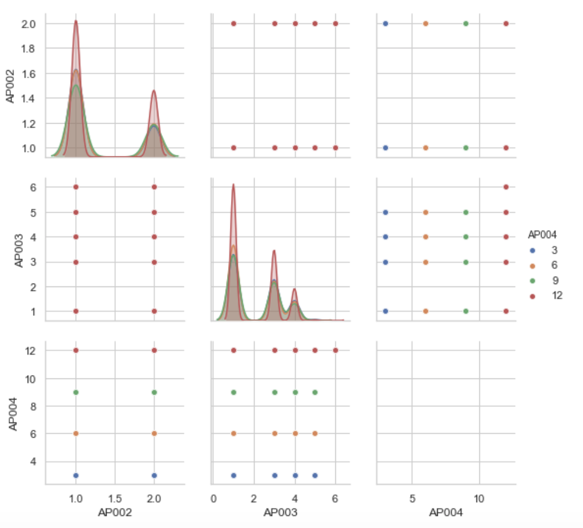
5420 Anomaly Detection, Fall 2020
- Harsh Dhanuka, hd2457
Exploratory Data Analysis
Checking relations between:
AP002 – Gender
AP003 – Education Code
AP004 – Loan Term
3

Slide 7
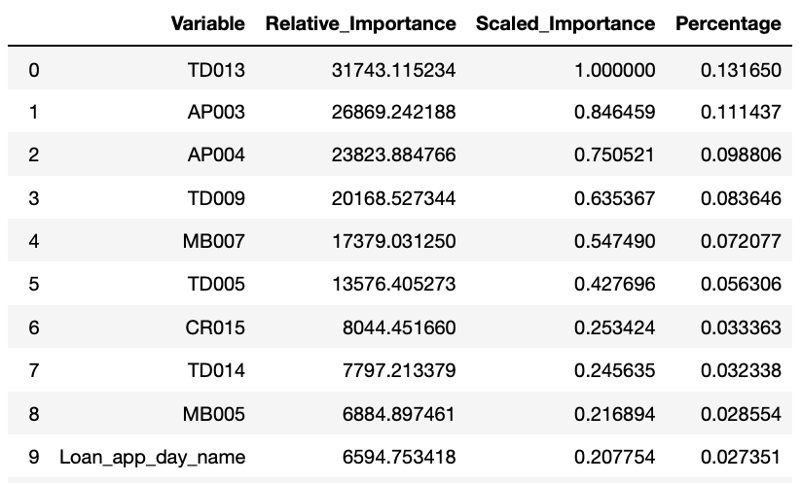
5420 Anomaly Detection, Fall 2020
- Harsh Dhanuka, hd2457
Random Forest Model
Model
1
2
Re-run the model after feature selection
Build 2 models:
1. balanced_classes = false
2. balanced_classes = true
Parameters:
ntrees = 400
nfolds = 10
min_rows = 100
Out of the total 75 variables, my model gives the best results when I use the top 50 features
Variable Importance
balanced_classes parameter did not make any difference in results
19.3% data is minority class

Slide 8
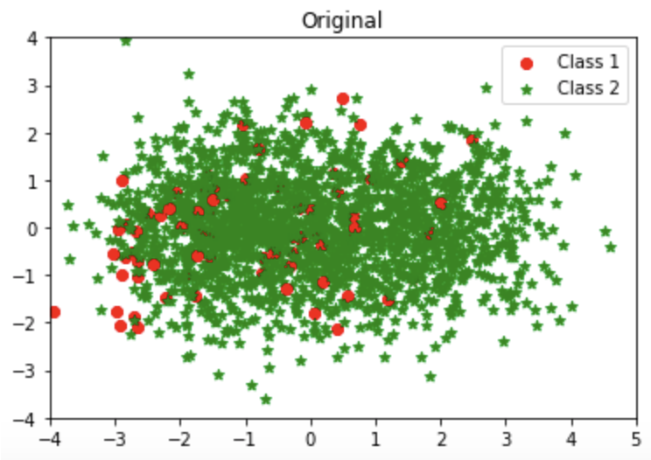
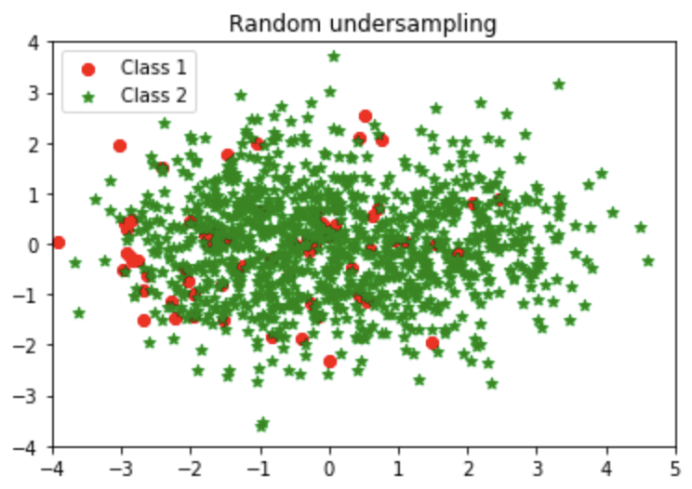
Random Under Sampling
Random Under Sampling is to under-sample the majority class randomly and uniformly. This can potentially lead to loss of information. But if the examples of the majority class are near to others, this method might yield good results.
Random Over Sampling
Random oversampling simply replicates randomly the minority class examples. Random oversampling is known to increase the likelihood of occurring overfitting. On the other hand, the major drawback of Random undersampling is that this method can discard useful data.

Slide 9
5420 Anomaly Detection, Fall 2020
- Harsh Dhanuka, hd2457
Random Forest Model
Discuss in detail the model which gave me the best ‘Lift’ and ‘Precision Recall’ score
1
Manual Over Sampling
Goal
I make both the classes in 1:1 ratio
So, 0’s (no defaults) and 1’s (defaults) both have 64512 entries each
Get high Lift score
Increase Precision Recall score
2
Random Forest Model with manual Over Sampling
3
Predictions
For predicting the loan default, I will not use a test set from the new oversampled/balanced data set.
I will use the originally split 25% dataset which was done before the 1st model.
Parameters:
ntrees = 400
nfolds = 10
min_rows = 100
balance_classes = False

Slide 10
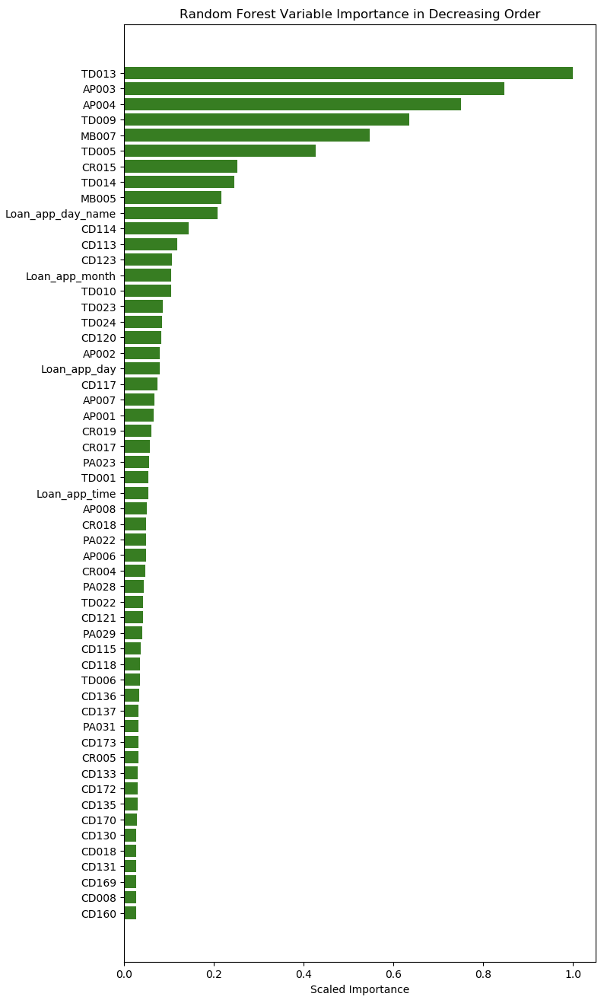
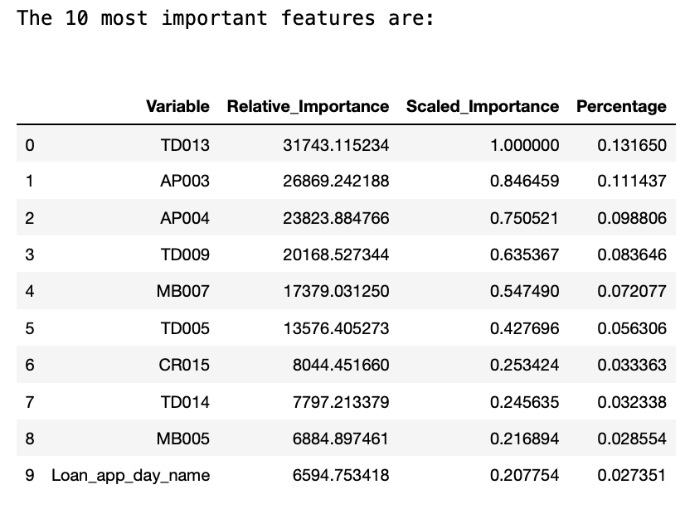
5420 Anomaly Detection, Fall 2020
- Harsh Dhanuka, hd2457
Random Forest Model
4
Feature Importance
TD013 – TD Count of Queries in last 6 months (P2P)
AP003 – Education Code

Slide 11
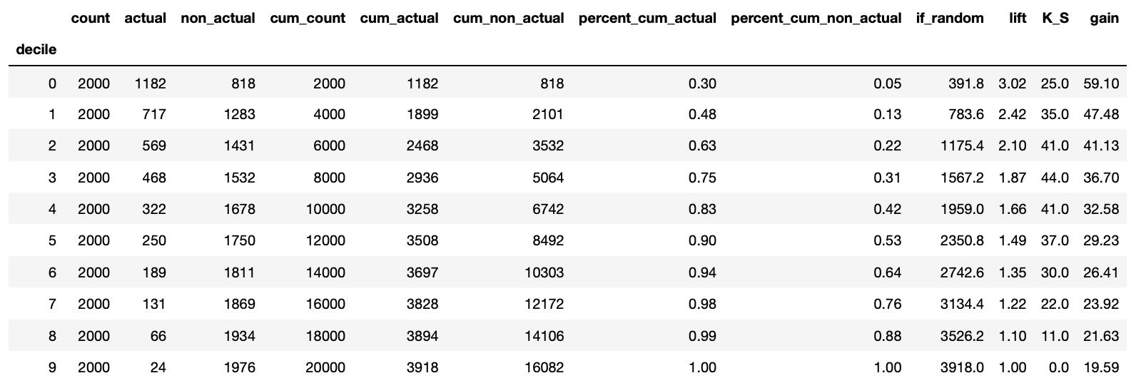
5420 Anomaly Detection, Fall 2020
- Harsh Dhanuka, hd2457
Random Forest Model
5
Gains Table and Lift
Lift is a measure of the effectiveness of a predictive model calculated as the ratio between the results obtained with and without the predictive model.

Slide 12
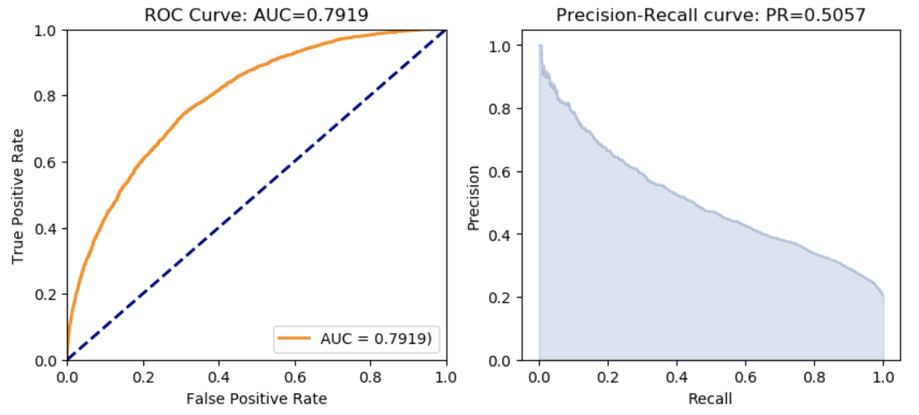
5420 Anomaly Detection, Fall 2020
- Harsh Dhanuka, hd2457
Random Forest Model
6
AUC and Precision Recall
ROC: The ROC curve plots the true positive rate vs. the false positive rate
AUC: A value between 0.5 (random) and 1.0 (perfect), measuring the prediction accuracy
Recall (R) = The number of true positives / (the number of true positives + the number of false negatives)

Slide 13
5420 Anomaly Detection, Fall 2020
- Harsh Dhanuka, hd2457
Business Insight
H2O package, Random Forest Model is a very effective and efficient tool to build a machine learning model for predicting loan defaults. Also, H2O package is very handy to display the variable importance, handle correlations, and also dummy code the categorical variables.
Lift: For the final model I built after tuning all the different models on various different values of each parameter, the highest Lift score I obtained is 3.02, which is very good as per industry standards. A Lift score of above 2 is suitable for the model to be of acceptable standards.
AUC is 0.79 and PR score is 0.50 which is of acceptable standards. So the model is stable and fine.
Random Forest through the H2O package is a good approach to predict loan default.
However, we should not undermine other good boosting models such as gbm, xgboost, or Auto-ML and others. These might provide better results as well.

